Slide 1
Instructions for investigating patent
US 9587003 B2

Slide 2
Open this link to access the patent
https://patents.google.com/patent/US9587003B2/en

Slide 3
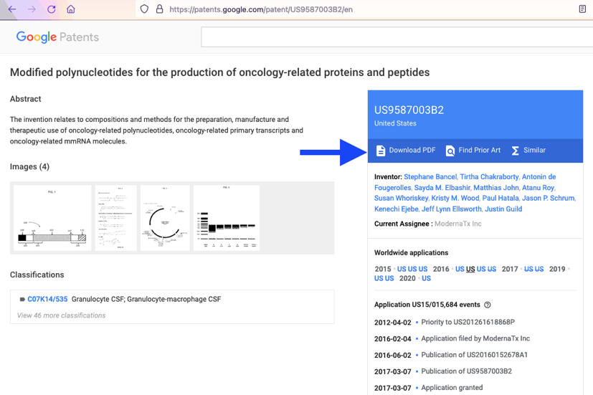
Download the entire pdf file

Slide 4
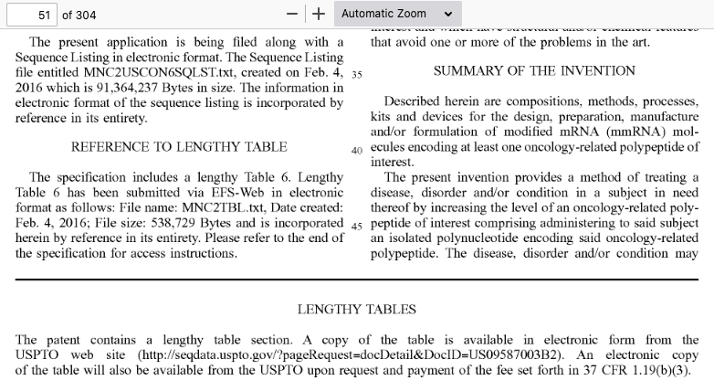
Scroll down to page 51 in the file

Slide 5
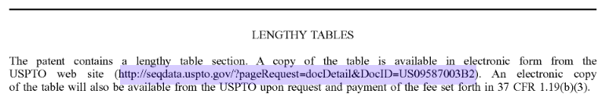
Open the link under the heading that says “LENGTHY TABLES”

Slide 6
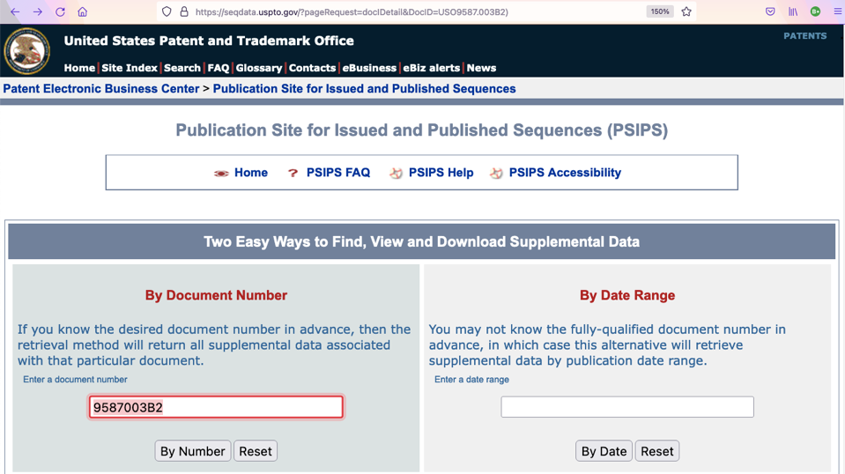
Enter the patent number into this box, then click on “By Number” to access the sequence

Slide 7
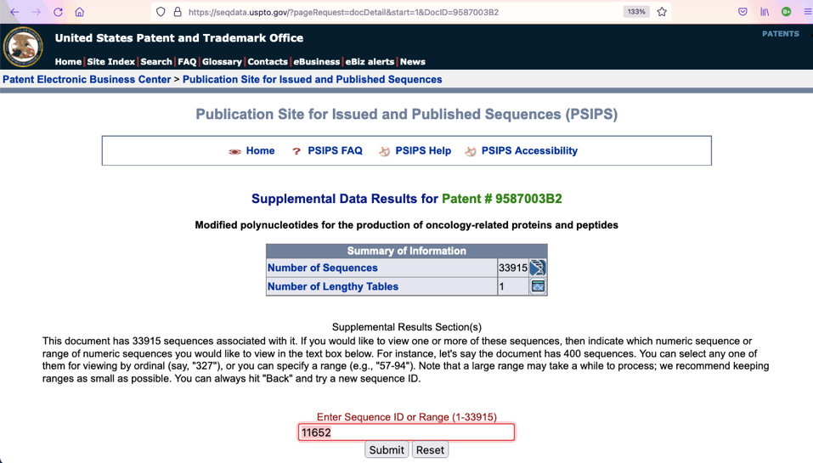
Enter sequence number 11652 in this box, then click on “Submit”

Slide 8
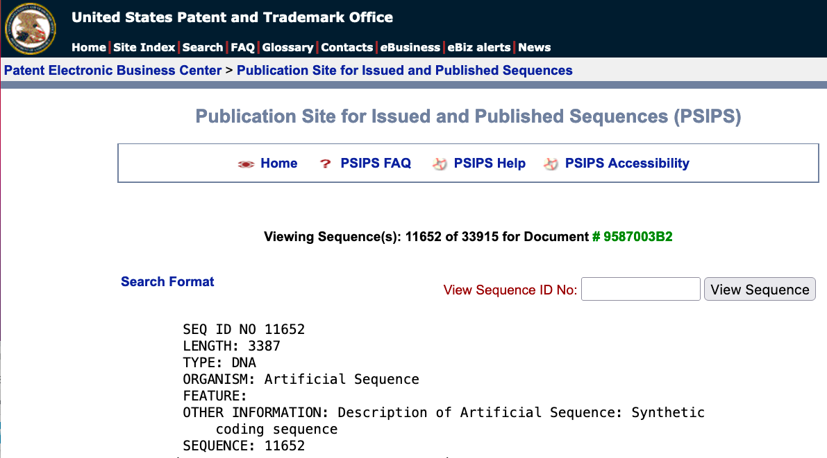
Your screen will display this sequence

Slide 9
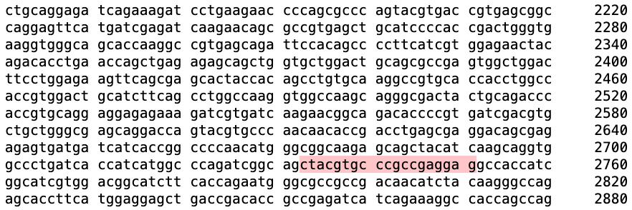
Highlight then copy this 19-letter sequence found in the 2760 region

Slide 10
Open a new browser instance, then proceed to open NIH’s database of gene sequences
https://blast.ncbi.nlm.nih.gov/Blast.cgi?PROGRAM=blastn&PAGE_TYPE=BlastSearch&LINK_LOC=blasthome

Slide 11
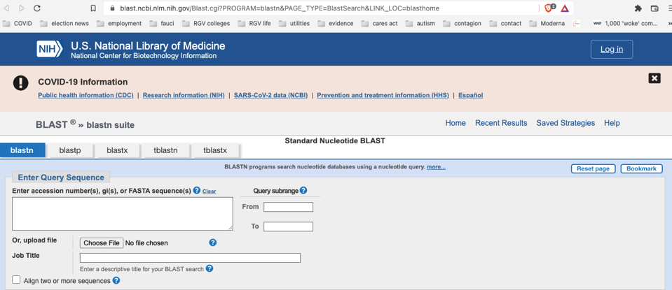
Your page will appear like this

Slide 12
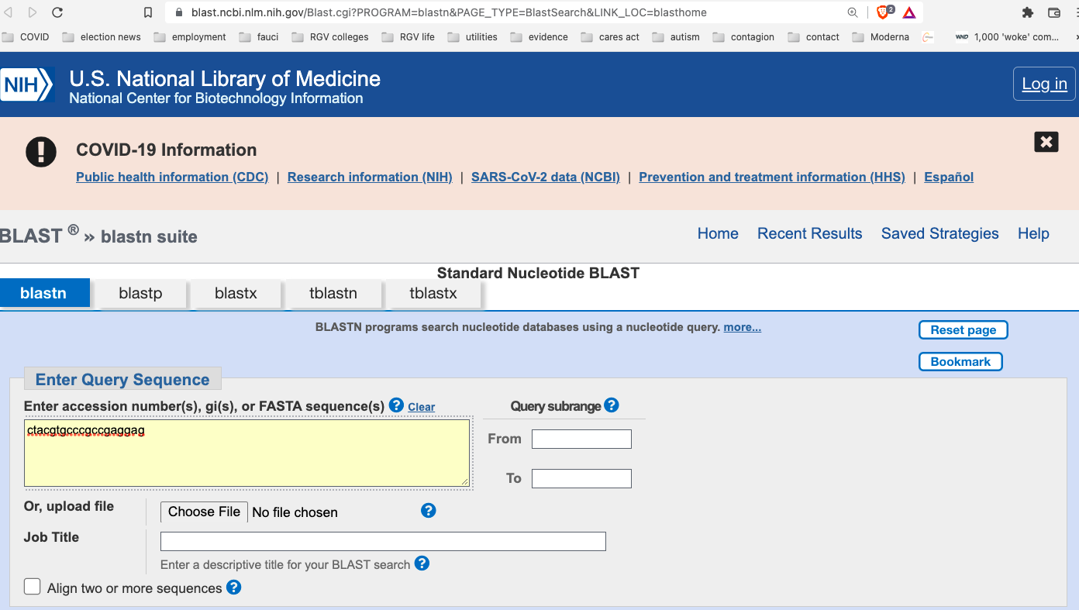
Place cursor in the “Enter Query Sequence” box indicated and paste copied sequence

Slide 13
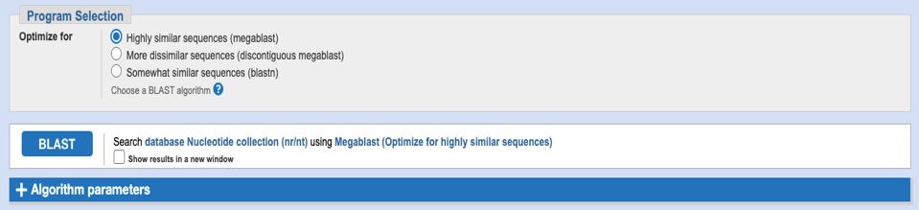
Scroll down to the bottom and then click on “BLAST”

Slide 14
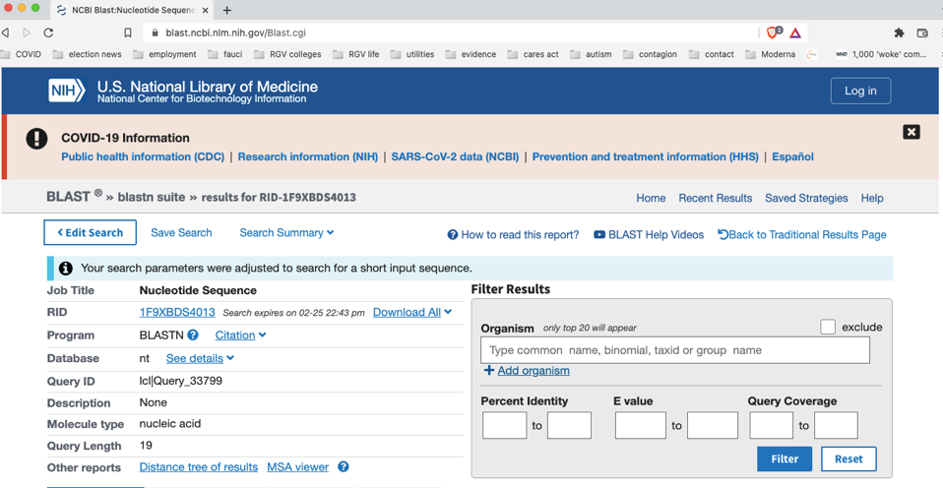
Your page will eventually appear like this
The search may take 5 minutes. Be patient!

Slide 15
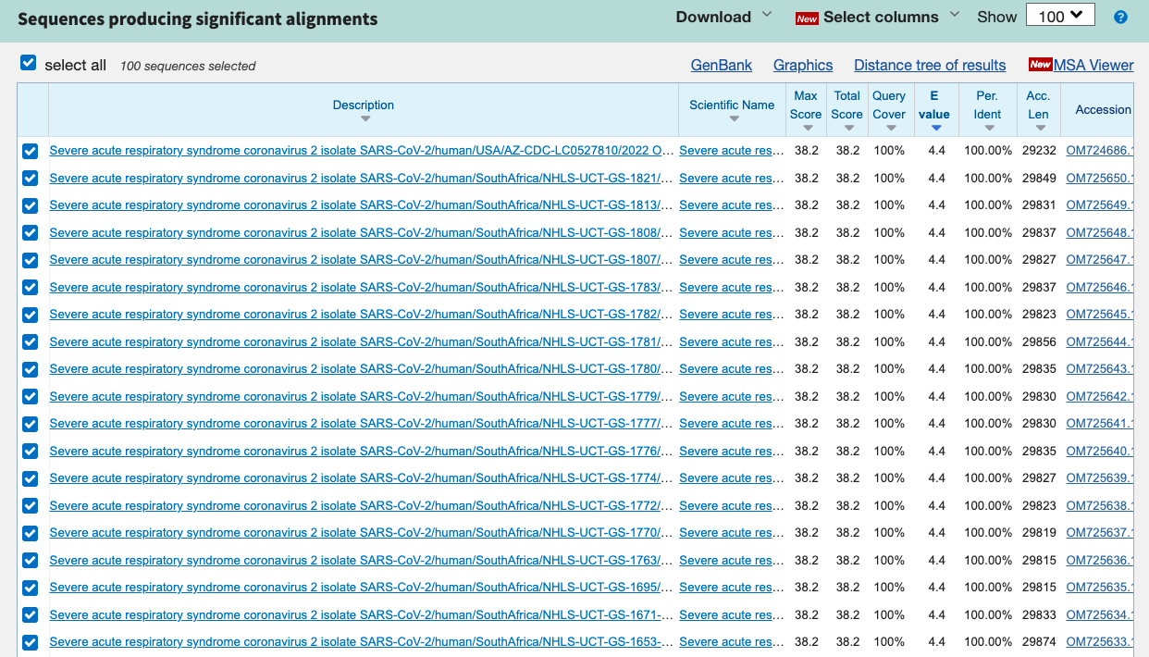
Scroll down and you will find links to all nucleotide sequences uploaded to NIH

Slide 16
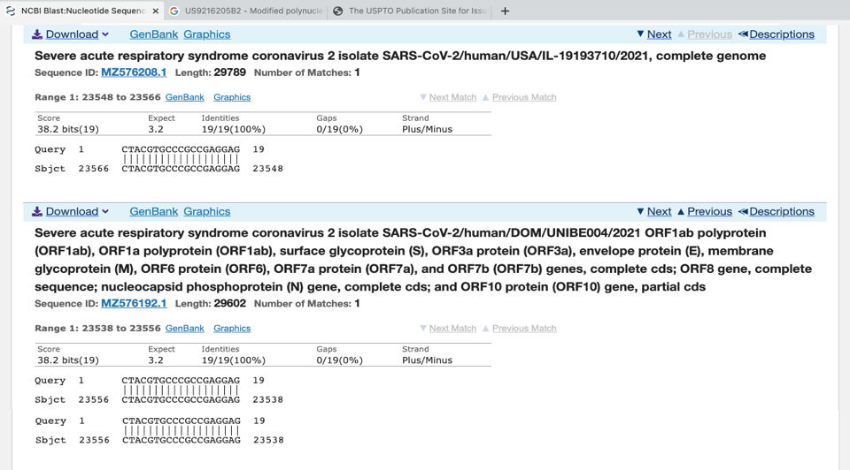
This is a sample of what you might see if you open one of these sequence links

Slide 17
What is the significance of these results?
In 2013 Moderna applied to patent a “modified polynucleotide” that contains a 19-base sequence that is the reverse compliment of a 19-base sequence in the COVID-19 virus.
This 19-base sequence does not occur in any other virus listed in the NIH database
This 19-base sequence contains the “furin cleavage site”(PRRAR)
The furin cleavage site plays a key role facilitating entry of the COVID-19 virus into human cells
The probability that the same 19-base sequence appeared in the virus by means of natural selection is 1 out of 3.6 trillion.

Slide 18

ACKNOWLEDGMENTS:
The power point is based on information provided in the following article:
https://www.frontiersin.org/articles/10.3389/fviro.2022.834808/full

